Slide 1

Prediction Modelling of Academic Performance A Data Mining Approach
Mvurya Mgala, mmgala@tum.ac.ke
Data Science for Africa Workshop in Arusha
30/04/2017
Technical University of Mombasa
Notes:
We are building classifier models using data

Slide 2

Millennium Development Goal #2 Achieve Universal Primary Education
http://worldteacheraid.org/imagine-your-first-day-of-school-in-kenya/
Notes:
Background
The second sacred goal by the world community is to achieve Universal Primary Education (UPE) by 2015
This explains why many countries in sub-Saharan Africa have adopted Free Primary Education (FPE)
Kenya has not been left behind, FPE was initiated in 2003 (Somerset, 2009)
The challenge now is to attain a balance between quantity of education and quality (Gakure et al., 2013)

Slide 3

2003:Kenya starts the Free Primary Education (FPE) Program
http://worldteacheraid.org/imagine-your-first-day-of-school-in-kenya/
Enrollment has increased from under 1M per year to over 1.3 M
Notes:
At the Millennium Summit in September 2000 the largest gathering of world leaders in history adopted the UN Millennium Declaration,
Background
•Kenya adopted the 8-4-4 system, 8 years in Primary, 4years in secondary, 4 years in university
•students have to pass Kenya Certificate of Primary Education (KCPE) national exam with 250 out of 500 marks otherwise they have failed
•

Slide 4




Challenges in Rural Public Schools
70% of students fail the Kenya Certificate of Primary Education Examination
They never make it to secondary school
Notes:
Remove the “Photo X” since it just takes up space
Use slide to make the problem statement

Slide 5
Consequences
The Rural community remains undereducated
They Lack Innovative skills
Resulting in social and economic under development

Slide 6

Predicting Modelling Using Data→ Motivating Interventions
Educational and Socio-economic Factors
Prediction of Need for Intervention
Prediction Model
Education Data Mining
Notes:
Motivation
We are proposing to solve the problem of poor performance at individual level, because policy solutions have not succeeded.
Understanding factors associated with poor academic performance is the starting point
Using these factors to categorize the potential failures and invoke intervention is the way forward
A Machine Learning Prediction model is a possible solution
Research Questions
What feature subset gives the best accuracy and is small enough for use in a mobile phone?
Which one among the selected common classifiers gives the best accuracy?

Slide 7
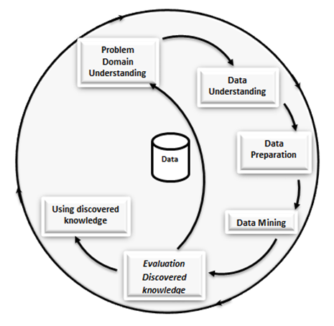
Adopted Framework: CRISP-DM
(Kurgan & Musilek, 2006)

Slide 8
Data Collection
Review of literature:
On factors that cause poor academic performance
E.g. the framework on factors causing poor academic performance (teacher, school, pupil and parent) (Etsey, 2005)
A survey:
with 7 education officers, 14 head teachers, 124 teachers in 13 primary, in Kwale County.
Data Collected:
2426 student records with 22 features were collected from Rural Schools
1105 Student records were collected from peri-urban schools.

Slide 9
Problem Domain Understanding
Through the Survey:
Findings reveal that poor academic performance exists in the County.
And that nearly 70% of the students who sit for KCPE do not achieve above the national average of 250 marks out of 500 total marks.

Slide 10
Data Understanding
achieved by examining the collected 2426 student records consisting of 22 fields from rural schools,
and the 1105 student records of 19 fields from peri-urban schools.
The examination entailed:
a consideration for the tools to be used for the type of data;
the fields that need conversion to make them usable in WEKA

Slide 11
Data Preparation: Pre-Processing/Feature Selection
determining the validity of the typed data,
cleaning the data by replacing missing values and deleting the records that did not have the target,
discretising some of the data,
and selecting the most predictive features:
(Test-marks, gender, family-income, student-age, teacher-shortage, student motivation, and study-time)

Slide 12
Data Mining
Six Common Classifiers Algorithms were experimented to build models
LR, SVM, ANN, NB, RF, DT were used to build the models using WEKA machine learning environment
The best model turned out to be Logistic Regression
A system that incorporates the model and a mobile application was developed

Slide 13
Evaluation
A comparison of the prediction performance for logistic regression on the different datasets was carried out.
Two metric measures were used for the evaluation process, F-Measure and ROC area.

Slide 14
The Evaluation Results
 | Model Prediction Performance
Metric | Full-rural dataset (22 features) | Optimal rural dataset (7 features) | Peri-urban dataset (19 features) | Peri-urban dataset (7 features)
ROC Area | 88.7% | 88.5% | 89.7% | 90.2%
F-Measure | 89.7% | 89.6% | 78.4% | 79.9%
ROC area Average Performance for full dataset: 89.2%
For Optimal Dataset: 89.35%

Slide 15
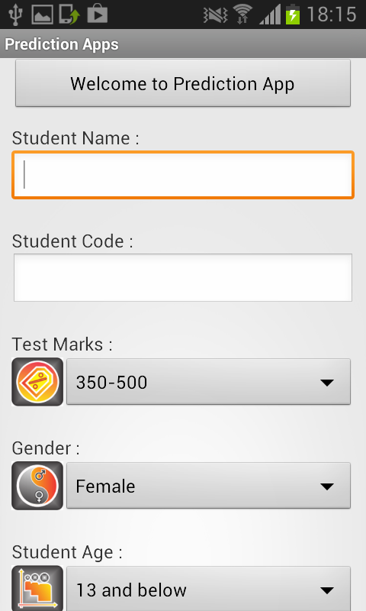
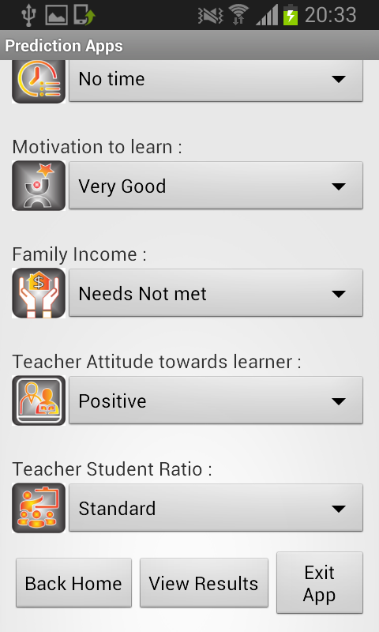
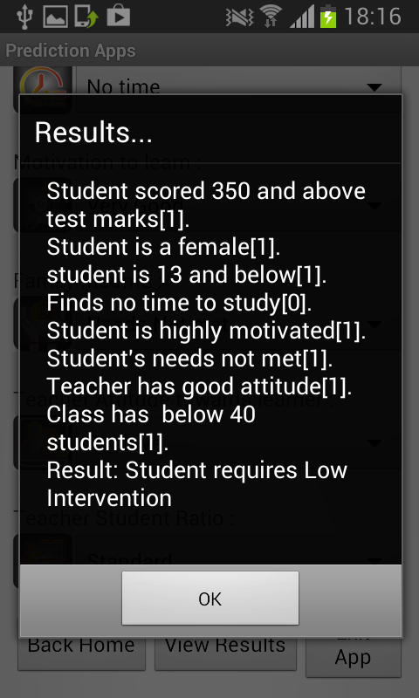
Using the Knowledge

Slide 16
Conclusion
Students that require high intervention can be predicted with nearly 90% Accuracy.
This high prediction performance of the model is what would motivate strategic intervention by education stakeholders.
The System achieved nearly 80% Accuracy.
The key factors, seven, were discovered.
Way Forward: Collect more data from different Counties and Regions to generalise the system

Slide 17
References
N. Güner, A. Yaldır, G. Gündüz, S. Tokat, and S. İplikçi, “Predicting Academically At-Risk Engineering Students : A Soft Computing Application,” vol. 11, no. 5, pp. 199–216, 2014.
A. Tamhane, S. Ikbal, B. Sengupta, M. Duggirala, and J. Appleton, “Predicting student risks through longitudinal analysis,” Proc. 20th ACM SIGKDD Int. Conf. Knowl. Discov. data Min. - KDD ’14, pp. 1544–1552, 2014.
C. M. Munyi and J. A. Orodho, “Wastage in Schools : What Are The Emerging Internal Efficiency Concerns in Public Primary Schools in Kyeni Division , Embu County , Kenya ?,” vol. 5, no. 6, pp. 135–147, 2015
O. Abagi, G. Odipo, and A. House, “Efficiency of Primary Education in Kenya : Situational Analysis and Implications for,” Inst. Policy Anal. Res. Discuss. Pap., no. September, 1997.
A. Somerset, “Universalising primary education in Kenya: the elusive goal,” Comparative Education, vol. 45, no. 2. pp. 233–250, 2009.
F. Bowles, “International Cooperation in Education,” J. Teach. Educ., vol. 17, no. 1, pp. 61–64, 1966.
R. W. Gakure, P. Mukuria, and P. P. Kithae, “An evaluation of factors that affect performance of primary schools in Kenya: A case study of Gatanga district,” Educ. Res. Rev., vol. 8, no. 13, pp. 927–937, 2013
K. Etsey, “Causes of low academic performance of primary school pupils in the Shama Sub-Metro of Shama Ahanta East Metropolitan Assembly (SAEMA) in Ghana,” 2005, pp. 1–34.
L. Yu and H. Liu, “Feature Selection for High-Dimensional Data: A Fast Correlation-Based Filter Solution,” Int. Conf. Mach. Learn., pp. 1–8, 2003.
R. Asif, A. Merceron, and M. K. Pathan, “Predicting Student Academic Performance at Degree Level: A Case Study,” Int. J. Intell. Syst. Appl., vol. 7, no. 1, pp. 49–61, 2014.
G. Mavis, “Family Community Partnerships and The Academic Achievement of African American, Urban Adolescents. Report No.7, 1996”

Slide 18

Questions?
Dr Mvurya Mgala
mmgala@tum.ac.ke
Technical University of Mombasa
Institute of Computing and Informatics

